Slide 1
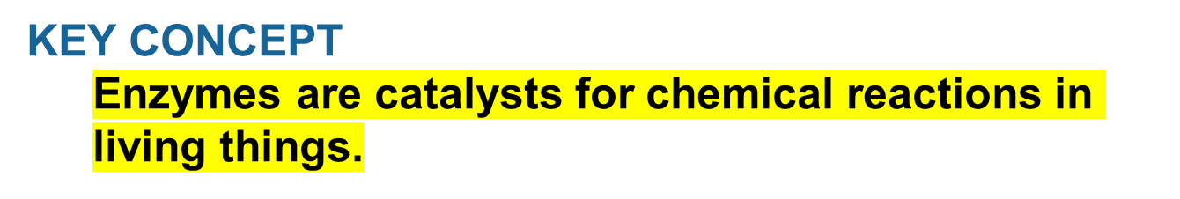
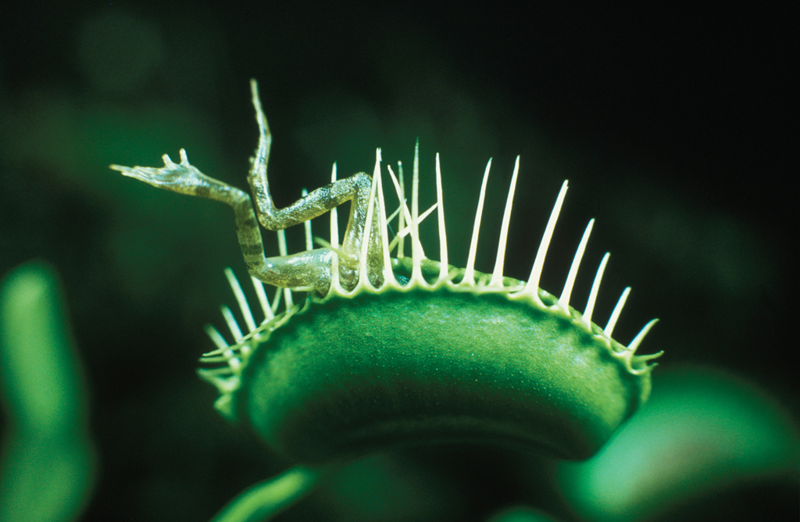

Slide 2
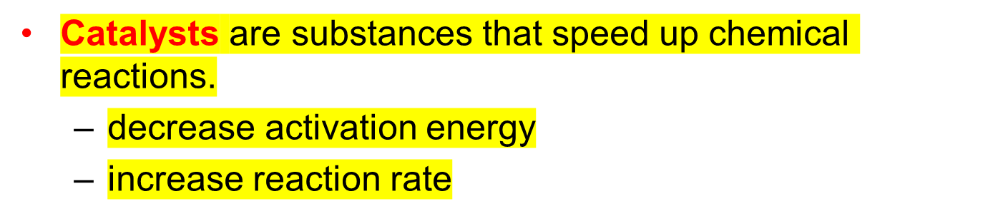
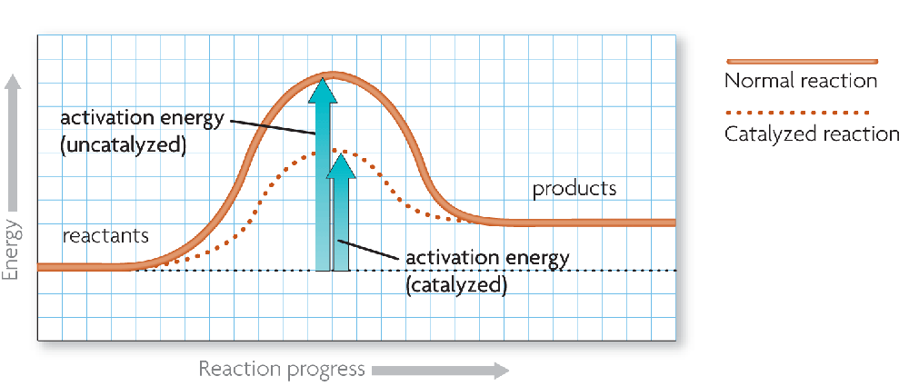

A catalyst lowers activation energy.

Slide 3
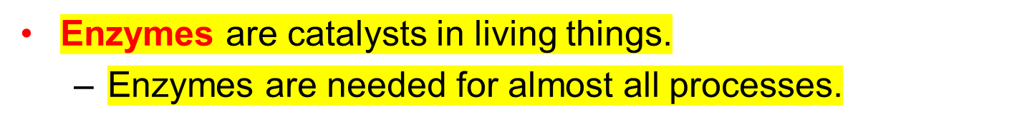
Enzymes allow chemical reactions to occur under tightly controlled conditions.

Slide 4
Disruptions in homeostasis can prevent enzymes from functioning.
  Enzymes function best in a small range of conditions.
  Changes in temperature and pH can break hydrogen bonds.
  An enzyme’s function depends on its structure.

Slide 5
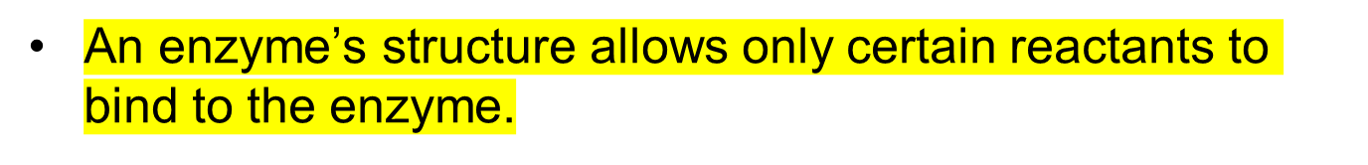
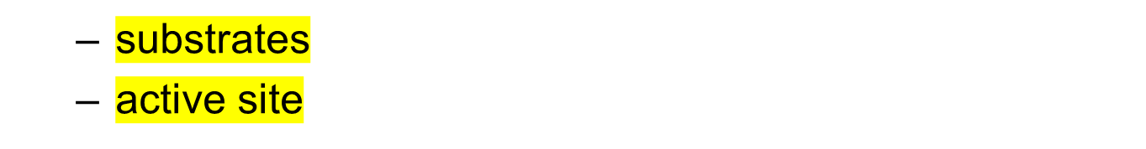
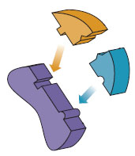
substrates
(reactants)
enzyme
Substrates bind to an
enzyme at certain places called active sites.

Slide 6
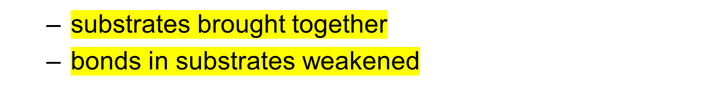
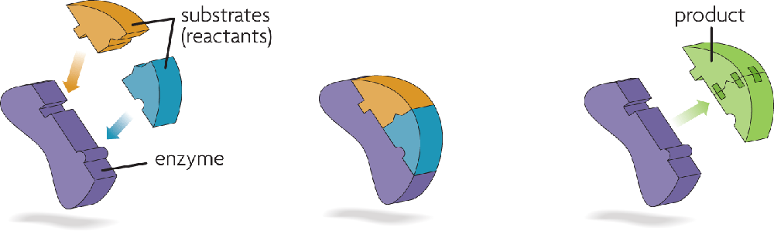
The lock-and-key model helps illustrate how enzymes function.
Substrates bind to an
enzyme at certain places called active sites.
The enzyme brings
substrates together and weakens their bonds.
The catalyzed reaction forms
a product that is released
from the enzyme.

Slide 7
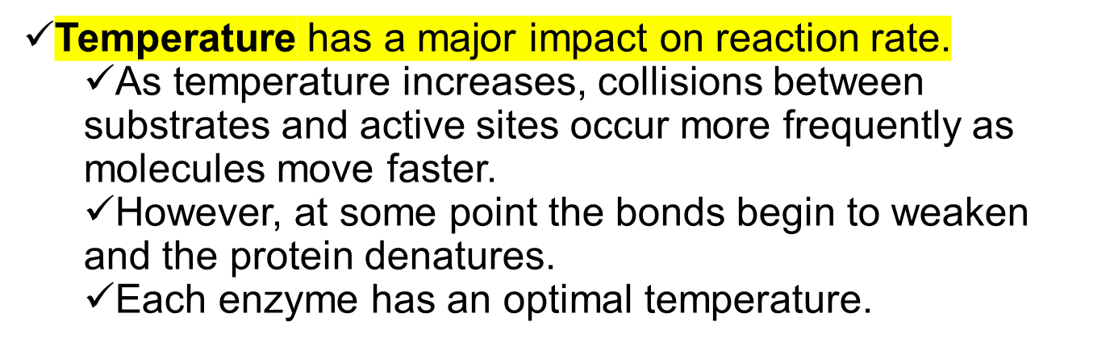
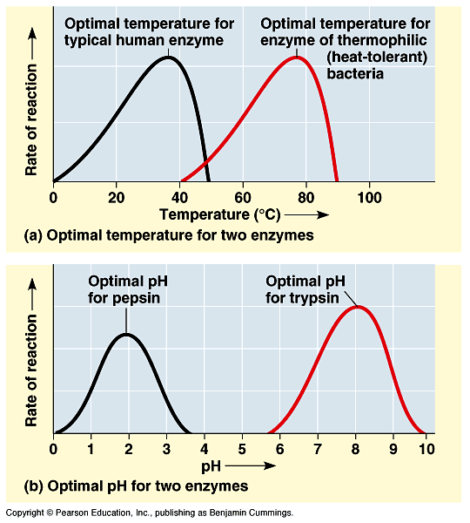
Factors that Affect Enzyme Activity

Slide 8

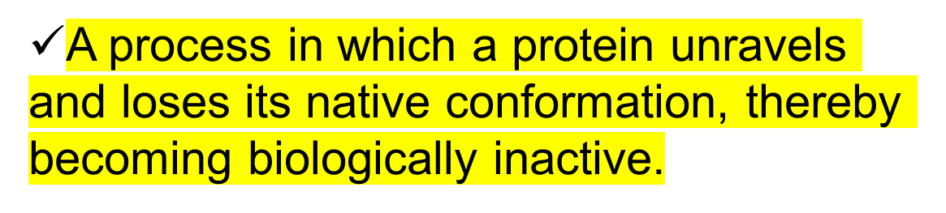
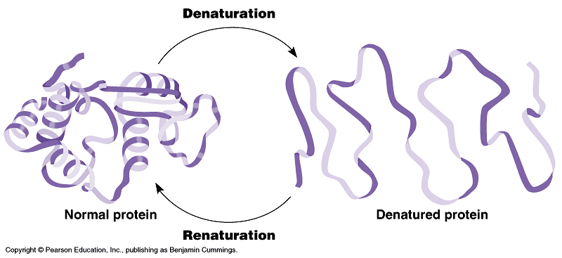

Slide 9
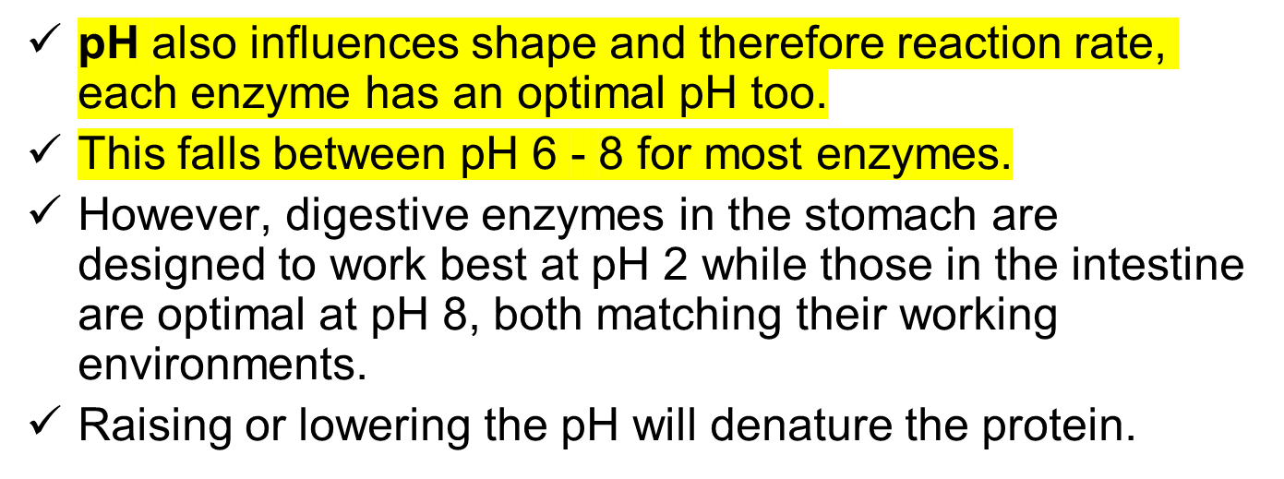

Slide 10
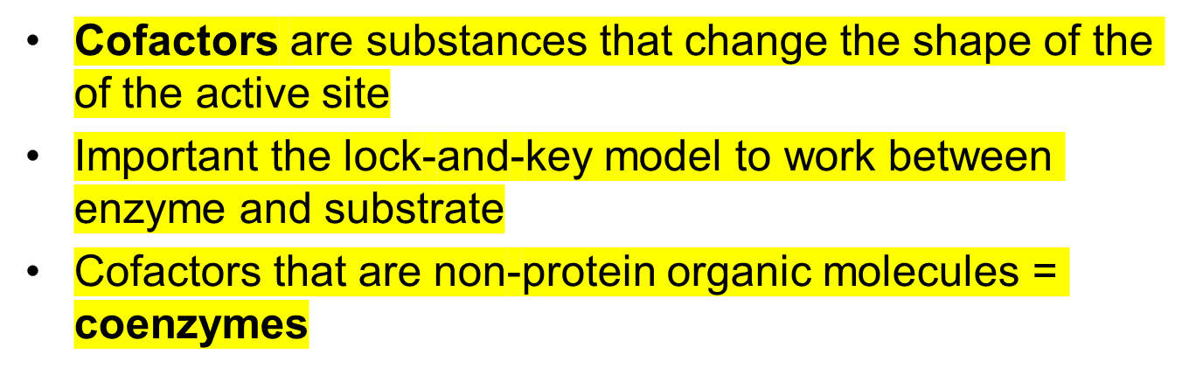
Cofactors and coenzymes

Slide 11
Exercises
  Describe how the interaction between an enzyme and its substrates changes a chemical reaction
  How does a catalyst affect the activation energy of a chemical reaction?
Some organisms live in very hot or very acidic environments. Would their enzymes function in a person’s cells? Why or why not?
Suppose the amino acids that make up an enzyme’s active site are changed. How might this change affect the enzyme?
Organisms need to maintain homeostasis. Why is homeostasis important for the function of enzymes?

